Slide 1
Case of the Month: Boosting the Beta Effect
Cynthia De la Garza Ramos, MD, Integrated IR Resident, Mayo Clinic Florida
Ricardo Paz-Fumagalli, MD, Associate Professor of Radiology, Mayo Clinic Florida
Beau B. Toskich, MD, Professor of Radiology, Mayo Clinic Florida

Slide 2
Clinical Presentation
55-year-old male with anemia
Work-up including upper endoscopy revealed esophageal varices
Abdominal imaging revealed:
Cirrhotic liver morphology with sequelae of portal hypertension
Lesion suspicious for hepatocellular carcinoma (HCC)
Referred to IR by the liver transplantation service
ALBI 2
Child-Pugh A
ECOG 1

Slide 3
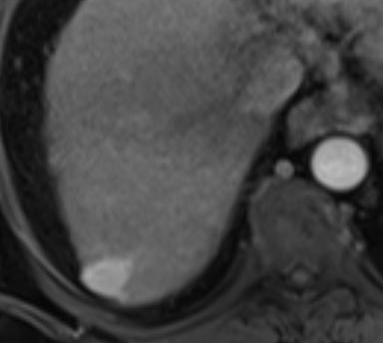
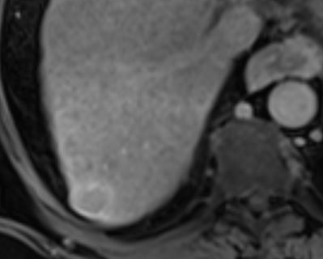
Pre-treatment contrast-enhanced MRI
Enhancement on arterial phase
Washout and pseudocapsule on delayed phase
UNOS 5B 2.2 cm HCC in hepatic segment VII

Slide 4
How would you treat this lesion?
A) Cryoablation
B) Microwave ablation
C) Radiation segmentectomy
D) Transarterial chemoembolization

Slide 5
How would you treat this lesion?
A) Cryoablation
B) Microwave ablation
C) Radiation segmentectomy
D) Transarterial chemoembolization

Slide 6
Technique
Access was gained into the right common femoral artery with a 6 French long curved hydrophilic sheath after administration of local anesthesia.
A reverse curve catheter was used to select the celiac artery and angiography was done.
A 5 French catheter was advanced into the right hepatic artery and right hepatic arteriography was done and complemented with cone beam CT.
A coaxial microcatheter was used to select 3 subsegmental arteries of the right hepatic artery territory, arteriography was done and complemented with cone beam CT.

Slide 7
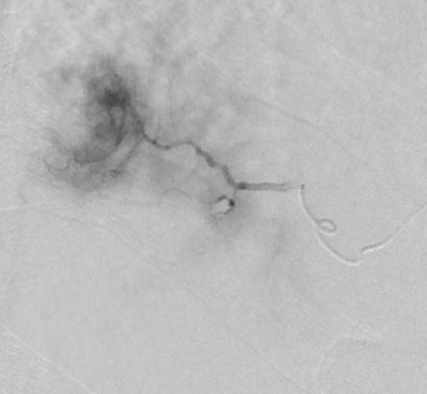
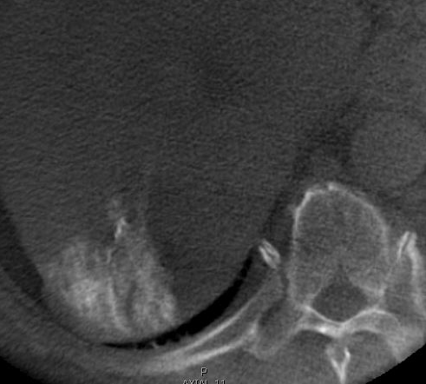
Selective arteriography of a segment 7/6 artery demonstrated​ hypervascularity within the tumor.
Cone beam CT demonstrated that the subcapsular portion of the​ tumor was not fed by the hepatic artery.
Notes:
The treatment
was directed to the dorsal aspect of the segment 7 artery.
IMPRESSION:
1. Ablative radioembolization of segment 7 hepatocellular carcinoma.
2. Peripheral contribution of flow from the inferior phrenic circulation (not included in
therapeutic territory).

Slide 8
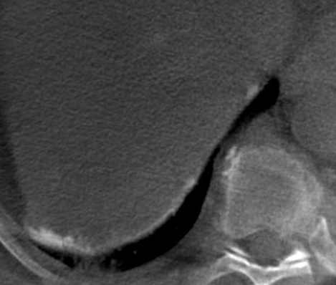
Technique
5. Selective catheterization of the right inferior phrenic artery was done. Arteriography was obtained and the microcatheter was then advanced into a third order branch of the inferior phrenic artery for additional arteriography. The inferior phrenic arteriograms were complemented with cone beam CT.
Right inferior phrenic arteriography demonstrated the​ peripheral portion of the tumor was fed by subcapsular arteries arising from this territory.​

Slide 9
Super-selective arteriography of branches of the inferior phrenic artery demonstrated that because of flow dynamics it would not be possible to effectively deliver Y90 microspheres to the portion of tumor fed from the extrahepatic territory.. T
How would you proceed?
A) Treat via the hepatic segment 6/7 artery alone and increase dose
B) Treat via the hepatic segment 6/7 artery alone and increase specific activity
C) A and B
D) Treat the hepatic segment 6/7 artery and the inferior phrenic artery with a standard dose

Slide 10
Super-selective arteriography of branches of the inferior phrenic artery demonstrated that because of flow dynamics it would not be possible to effectively deliver Y90 microspheres
to the portion of tumor fed from the extrahepatic territory.. T
How would you proceed?
A) Treat via the hepatic segment 6/7 artery alone and increase dose
B) Treat via the hepatic segment 6/7 artery alone and increase specific activity
C) A and B
D) Treat the hepatic segment 6/7 artery and the inferior phrenic artery with a standard dose

Slide 11
Technique
6. Y90 glass microspheres were directed to the dorsal aspect of the hepatic segment 7 artery.
7. A Perclose ProGlide device was used for closure of the right femoral artery access site.

Slide 12
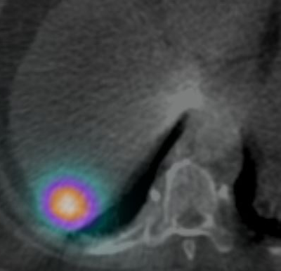
Post-treatment
Dosimetry
Angiosome volume: 42 mL
Treatment activity: 0.82 GBq
MIRD dose: 904 Gy
Particle number: 1.2 x 10⁶
Specific activity: 683 Bq
Assuming 2500 Bq at calibration
First week Friday
Bremsstrahlung SPECT/CT after administration of Y90 glass microspheres demonstrated​ very conformal deposition of activity in a subcapsular location within segment 7. No extrahepatic​ activity identified.​

Slide 13
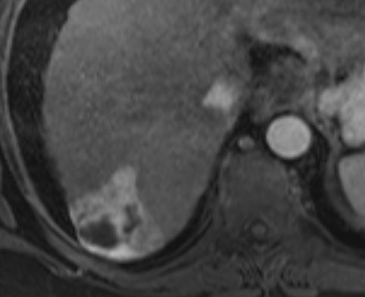
Follow-up: 1 month
Necrotic lesion in hepatic segment VII without evidence of residual or recurrent disease.
Complete response at 1 month.

Slide 14
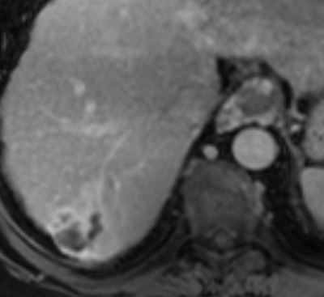
Follow-up: 4 months
Radioembolization changes in segment VII without nodular enhancement to suggest local recurrence.
Persistence of complete response.
Successful liver transplantation.

Slide 15
Radiation segmentectomy
Ablative radioembolization to expendable volumes of liver
Early-stage HCC:
Target tumor control comparable to thermal ablation and resection
Complete pathologic response is associated with:
Doses >500 Gy
Specific activity (up to 8-day decay)

Slide 16
Yttrium-90 β-particle emission energy spectrum:
Mean tissue penetration depth 2.5 mm (highest probability particle)
Maximum 11 mm (lowest probability particle)
90% deposition within 5.3 mm
Higher radiation dose and specific activity increase the number of intra-tumoral high energy β-particle decay events.
Y-90
2-11 mm

Slide 17
Key Points
Radiation segmentectomy is an ablative therapy and is potentially curative in small HCC
Intensifying dose and specific activity can optimize the ablative capacity of Y90 glass microspheres.
Mitigate radiation watershed arising from heterogeneous microsphere distribution.
Generate an ablative radiation margin which can improve tumor response.
Treatment response for high dose radiation segmentectomy can be seen earlier (~1 month) vs ~3-6 months for standard ablative radioembolization

Slide 18
References
Lewandowski RJ, Gabr A, Abouchaleh N, et al. Radiation segmentectomy: Potential curative therapy for early hepatocellular carcinoma. Radiology. 2018;287(3):1050-1058.
De la Garza-Ramos C, Montazeri SA, Croome KP, et al. Radiation Segmentectomy for the Treatment of Solitary Hepatocellular Carcinoma: Can Outcomes Be Compared to Surgical Resection? J Vasc Interv Radiol. March 2022.
Montazeri SA, De la Garza-Ramos C, Lewis AR, et al. Hepatocellular carcinoma radiation segmentectomy treatment intensification prior to liver transplantation increases rates of complete pathologic necrosis: an explant analysis of 75 tumors. Eur J Nucl Med Mol Imaging. April 2022.
Mourad SN, De la Garza-Ramos C, Toskich BB. Radiation Segmentectomy Above 1,000 Gy for the Treatment of Hepatocellular Carcinoma: Is There a Dose Limit?. J Vasc Interv Radiol. 2023;34(8):1458-1462.

